Slide 1
Chapter 13
Comparing Two Samples

Slide 2
Outline
Comparing Two Distributions
Comparing the Sample Means
Comparing Sample Variances
Summary
Self-Quiz unit 5

Slide 3
Comparing Two Distributions
So far we have studied the tools for the investigation of the characteristics of the distribution of a single measurement
Now we are going to see tools to make inference regarding the relationships between several measurements
We will try to understand how the outcome of one measurement affects the outcome of another measurement
An explanatory variable is a variable whose values affect the distribution of another variable called the response variable.

Slide 4


Comparing the Sample Means
The book provides good explanations how to use the R function “Plot()” and “t.test” for the purpose of comparing the sample means.
This section is concerned with the comparison of two populations with different distribution.
The confidence interval for the difference in sample means is given by the following formula:
.
.
.
And the boundaries (lower and upper bound) of this interval is summarized as follow:

Slide 5

Comparing the Sample Means
The test-statistics when performing the hypothesis test for the difference in means is given by:

Slide 6

Comparing Sample Variances
In this section, we are comparing the variance of two populations with different distributions
The comparison of variances from two populations is done with a new random variable obtained as a ratio of the estimators of the variances. This random variable follow the F-distribution:
.
.
The distribution of this random variable is denoted the F-distribution.
This distribution is characterized by the number of degrees of freedom associated with the estimator of the variance at the numerator and by the number of degrees of freedom associated with the estimator of the variance at the denominator.
The number of degrees of freedom associated with the estimation of each variance is the number of observation used for the computation of the estimator, minus 1.

Slide 7
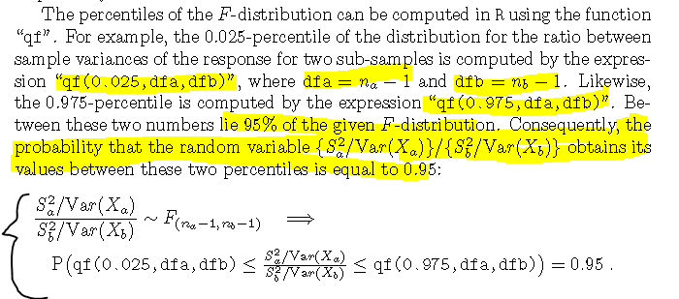
Comparing Sample Variances

Slide 8

Comparing Sample Variances
In the current setting the numbers of degrees of freedom are na-1 and nb-1,respectively.
The percentiles of the F-distribution can be computed in R using the function “qf". The R function var.test() will produce the test and the confidence interval.
The confidence interval for the ratio between variances is formulated as followed:

Slide 9
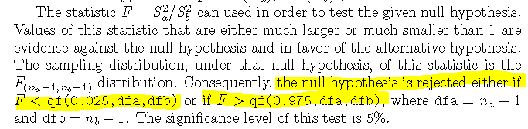
Comparing Sample Variances

Slide 10
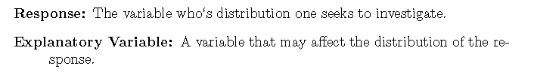
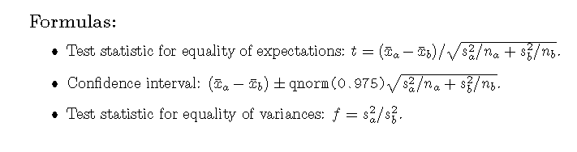
Summary

Slide 11
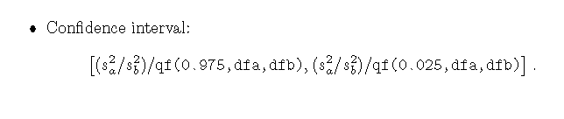
Summary

Slide 12
Self-Quiz Unit 5
# Q1 - Q4: https://youtu.be/-HY3qwbP2eo
# Q5 - Q7: https://youtu.be/zl5JhafA-hY
# Q8 -Q10: https://youtu.be/wepmTirnNkQ

